Slide 1
OpenDaylight Overview for Developers David Meyer Chair, OpenDaylight Technical Steering Committee

Slide 2
Agenda for this session
Brief OpenDaylight intro / recap
OpenDaylight architecture overview
Getting involved in the OpenDaylight Project
Q&A with Technical Steering Committee Members

Slide 3
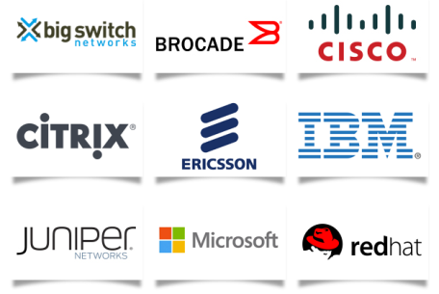

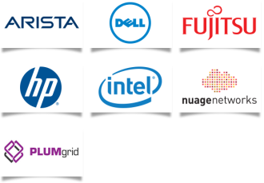

What is OpenDaylight?
OpenDaylight is an open source project under the Linux Foundation with the mutual goal of furthering the adoption and innovation of Software Defined Networking (SDN) through the creation of a common industry supported framework.
Platinum
Gold
Silver
Members as of April 8, 2013 and growing

Slide 4


OpenDaylight goals
Code: To create a robust, extensible, open source code base that covers the major common components required to build an SDN solution
Acceptance: To get broad industry acceptance amongst vendors and users
Community: To have a thriving and growing technical community contributing to the code base, using the code in commercial products, and adding value above, below and around
Key Principles: Open, transparent, fair

Slide 5

OpenDaylight code
A wide array of technologies contributed by leading companies and developers
Open Source: Any developer can contribute code as an individual
Robust framework/platform for new apps and tools
Eclipse Public License (EPL)
So what is the ODP architecture?
5

Slide 6

OpenDaylight SDN platform architecture framework
GUI
multi-tenant virtual networks
L4-L7 service abstractions
integration
network applications, orchestration, and services
OpenStack Quantum
CloudStack
oVirt
…
CLI
OpenDaylight APIs (REST)
base network service functions
virtual network manager
storage services
topology mgr
stats mgr
switch / device mgr
fwding
…
inter-controller comm
L4-L7 service manager
extensions / addn’l svcs
controller platform
service abstraction layer (plug-in mgr., capability abstractions, …)
OpenFlow
Open switch API
SAN (SMI-S)
other std. protocols (ONF, IETF, …)
vendor-specific interfaces
southbound interfaces & protocol plugins
1.0
1.3
hw-independent interfaces and data models
virtual forwarding enhancements
data plane interfaces and enhancements (virtual switches, physical device interfaces)

Slide 7
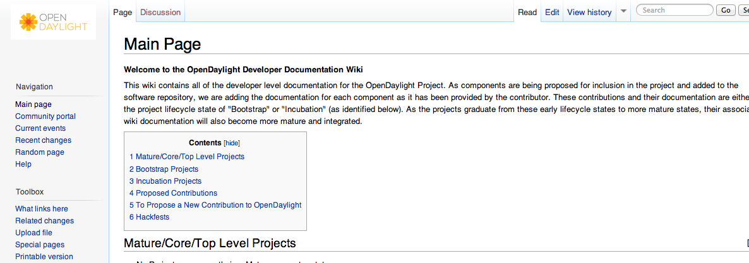
Getting started with OpenDaylight projects
Developer documentation: wiki.opendaylight.org
list of current projects in various states
links to documentation on current projects, e.g., how to get/build code, architecture, etc.
information on proposing new projects for OpenDaylight

Slide 8
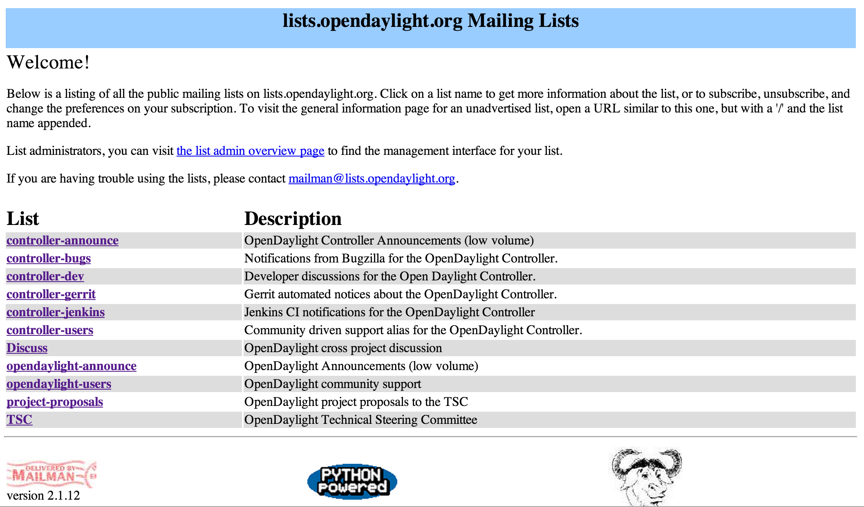
Getting involved in OpenDaylight discussions
Open mailing lists: lists.opendaylight.org
discussion groups on specific projects
cross-project discussions
announcements

Slide 9
OpenDaylight governance – 10K view
Bylaws: http://www.opendaylight.org/project/bylaws
ODP Board of Directors will manage business leadership for OpenDaylight including governance, marketing and operational decisions
Initial BOD populated by Platinum members + 1 gold + 1 silver
ODP Technical Steering Committee sets technical direction
TSC provides technical leadership for OpenDaylight
TSC members are elected and is comprised of developers and project leaders
Initially seeded with Platinum member representatives
TSC chair ex-officio member of the Board
TSC chair elected annually with no term limits
Importantly: OpenDaylight is open to anyone. In particular
Anyone can develop and contribute code
Anyone get elected to the Technical Steering Committee
Anyone can get elected to the Board
Anyone can help steer a project forward in any number of ways

Slide 10
A Little More on the TSC
Technical direction set by the Technical Steering Committee
Responsible for maintaining platform codebase
Sets release train scope and schedule
TSC membership
Initialized with representatives from platinum member companies
Will evolve to be comprised of core project leads and community representatives
TSC meetings and mailing list are open to the community
See lists.opendaylight.org to subscribe to the TSC mailing list
Meetings currently Thursdays at 1000 PDT
Dial in information will be published on tsc@opendaylight.org
“technical work stream” calls Monday and Wednesday at 1300 PDT
Minutes
All decisions documented and recorded, posted on public web site

Slide 11
OpenDaylight project lifecycle
proposed
All project graduation reviews managed by TSC
“bootstrap”
temporary entry point for projects during startup phase
new projects (not yet part of OpenDaylight)
incubation
core
nascent projects
projects core to OpenDaylight platform
mature
successful, active projects, perhaps with limited community

Slide 12
Q&A with the TSC

